Slide 1
DATAVIZ 300 Week 7: Enabling Organizations with Data

Slide 2
Guest Speaker Zachary Ahrens Final Project Last Thoughts on Design Expectations

Slide 3
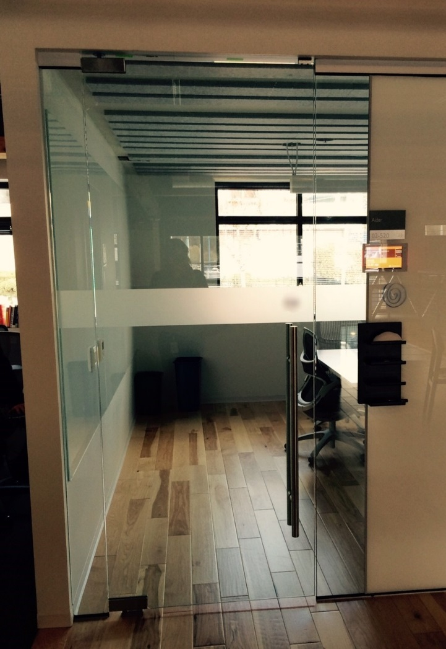
How do we open this door?

Slide 4


Slide 5

How about this one?

Slide 6


Slide 7
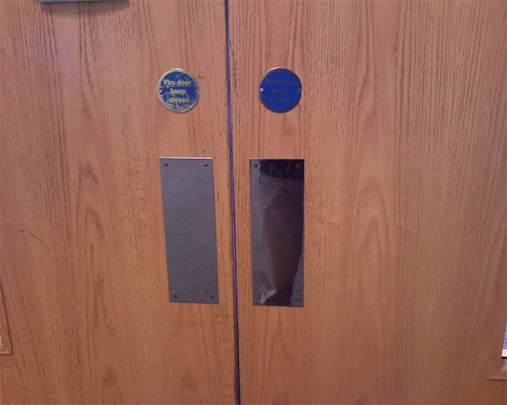
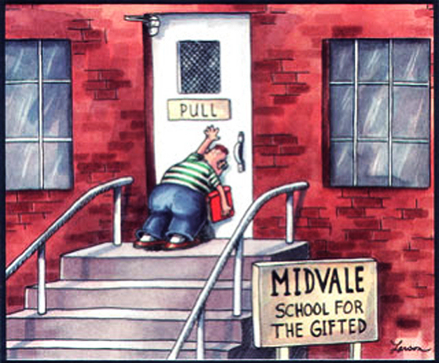


Slide 8


Slide 9

What does it mean for a dashboard to effectively communicate?

Slide 10
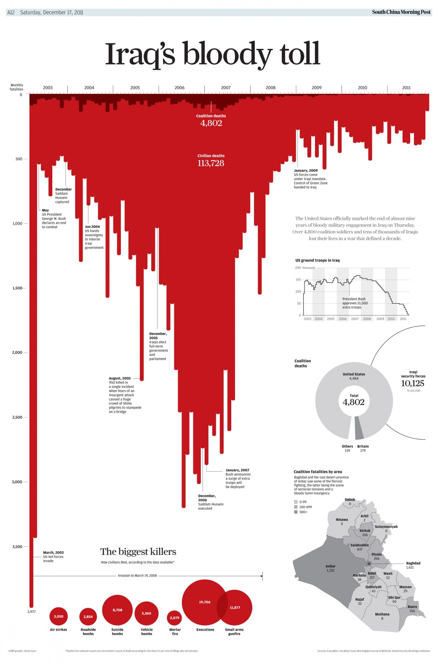

Slide 11
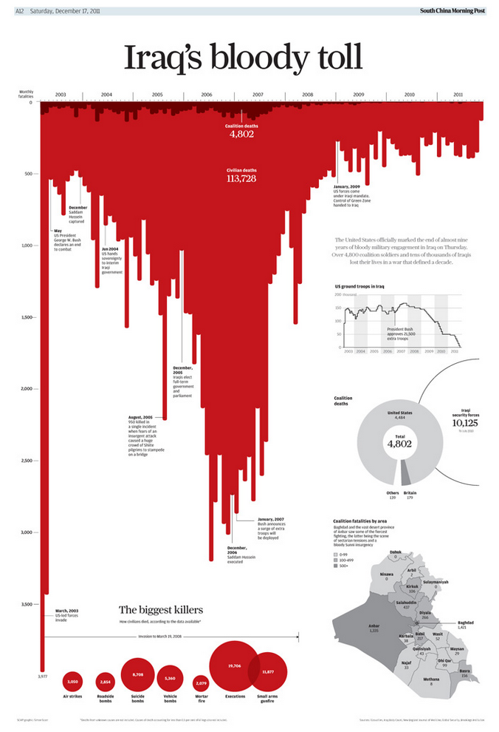


http://graphics-info.blogspot.hk/2012/09/malofiej-20-look-at-our-participation.html
Notes:
Finally, even when sticking with good design principles you have loads of options to consider when designing. And these choices will control the message your viz has. Every viz should have a message. Let’s see what we can do with this.
First off, let’s look at 3 things he did
The title: that’s enough to tell you his message: he’s emphasising the LOSS of life.
Was his choice of red neutral? Of course not – it’s blood.
Bar charts normally go up. What does this one go down? To look like a blood smear.

Slide 12
Iraq: Deaths on the decline
http://graphics-info.blogspot.hk/2012/09/malofiej-20-look-at-our-participation.html
Notes:
What can we do to this chart to change the message without even changing the vizzes>
Rotate the viz. Now the drop in deaths is clearer.
Change the title: that controls the message
Change the colour to something more neutral.
Pause: notice how the message is completely different.

Slide 13
“When I am working on a problem, I never think about beauty. I only think about how to solve the problem. But when I have finished, if the solution is not beautiful, I know it is wrong.”
- R. Buckminster Fuller
Notes:
What can we do to this chart to change the message without even changing the vizzes>
Rotate the viz. Now the drop in deaths is clearer.
Change the title: that controls the message
Change the colour to something more neutral.
Pause: notice how the message is completely different.

Slide 14
Guiding Questions
DISCOVERY
Whom does this dashboard serve?
What is the dashboard meant to tell them?
What specific action(s) should the dashboard drive?
“What would happen if this report didn’t exist?”
EVALUATION
Does the dashboard effectively convey the message?
Does the dashboard effectively support the desired action?
“Where is your eye drawn?”

Slide 15
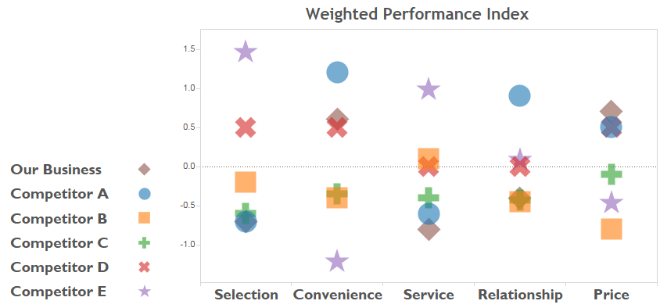

Slide 16
Guiding Questions
Whom does this visualization serve?
What is the visualization meant to tell them?
What specific action(s) should the visualization drive?
Executives
How our customers view us compared to our competition
Decide where to focus budget/training to maintain/increase market share against competitors

Slide 17
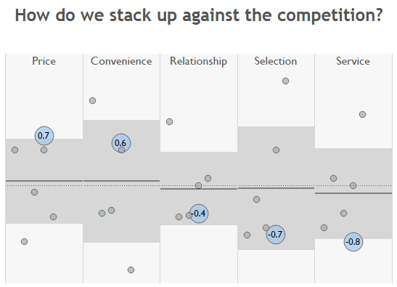

Slide 18
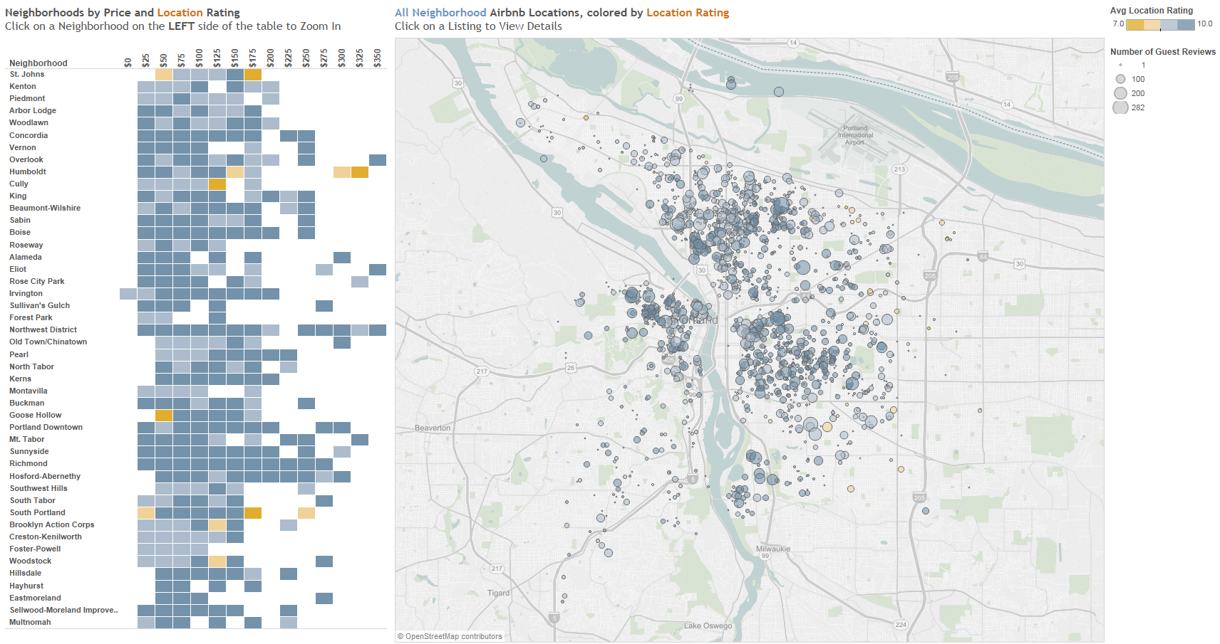

Slide 19
Whom does this visualization serve?
First time visitors to Portland
What is the visualization meant to tell them?
Where should they stay for most fun neighborhoods & best price
What specific action(s) should the visualization drive?
Narrow down their options so they can book the best one
Effectiveness
Quantitative | Ordinal | Categorical
Position | Position | Position
Length | Size | Different Colors
Size | Color Intensity | Shape
Color Intensity | *Different Colors
 | *Different Shapes

Slide 20
Takeaways
Design in service of communication first, aesthetics second
Well-designed dashboards convert analytical insights into action
Start with the Guiding Questions to understand what your audience needs – begin with the end in mind!
Leverage principles of perception to communicate
effectively

Slide 21
To Pass the Class: 1. Attend Class 2. Submit a visualization - 3 separate visual elements included - Multiple dimensions in each visualization 3. Submit the Post-Mortem

Slide 22
Post Mortem Questions DISCOVERY 1. Whom does your visualization serve? 2. What is the visualization meant to tell them? 3. What specific action(s) should the visualization drive? [I.e., What would happen if this report didn’t exist?”] EVALUATION 4. How does the visualization effectively convey the message? [I.e., Which Visual Best Practices or Cognitive elements did you use?] 5. How does the visualization effectively support the desired action? REFLECTION 6. Why did you develop this visualization? 7. How can you apply what you learned in the future? 8. What would have done differently with hindsight?

Slide 23
How do I evaluate? STEP 1: Looking at the answers to your three discovery questions I will on my own answer the evaluation question, by asking: Is there a point? Do you support that point? Do Do you utilize visual best practices to have an aha moment? Do your Visualizations drives insights for the user to take an action?

Slide 24
Breaking Down a Story
What’s Your Point?
Support Your Point.
Plot Twist!
Now What?
Notes:
What’s your point? – Call out the point in the title.
Support your point. – They spent the rest of the time supporting it.
Plot Twist. – Not only are they doing badly, only 6 students passed reading and math. Sometimes it’s the story. Sometimes it’s a data point.
Now What. – They followed up with a call to Action.

Slide 25
Post Mortem Questions DISCOVERY 1. Whom does your visualization serve? 2. What is the visualization meant to tell them? 3. What specific action(s) should the visualization drive? [I.e., What would happen if this report didn’t exist?”] EVALUATION 4. How does the visualization effectively convey the message? [I.e., Which Visual Best Practices or Cognitive elements did you use?] 5. How does the visualization effectively support the desired action? REFLECTION 6. Why did you develop this visualization? 7. How can you apply what you learned in the future? 8. What would have done differently with hindsight?

Slide 26
How do I evaluate? STEP 2: I will compare them to your answers to the evaluation section to ensure you have understanding. Do they match your answers in the post-mortem?

Slide 27
Post Mortem Questions DISCOVERY 1. Whom does your visualization serve? 2. What is the visualization meant to tell them? 3. What specific action(s) should the visualization drive? [I.e., What would happen if this report didn’t exist?”] EVALUATION 4. How does the visualization effectively convey the message? [I.e., Which Visual Best Practices or Cognitive elements did you use?] 5. How does the visualization effectively support the desired action? REFLECTION 6. Why did you develop this visualization? 7. How can you apply what you learned in the future? 8. What would have done differently with hindsight?

Slide 28
How do I evaluate? STEP 3: If not, are you aware in the reflection section of your weakness and would you approach it differently next time? If I do not see cognition, I will reach out to you by email for clarification or to set up a call.

Slide 29
Post Mortem Questions DISCOVERY 1. Whom does your visualization serve? 2. What is the visualization meant to tell them? 3. What specific action(s) should the visualization drive? [I.e., What would happen if this report didn’t exist?”] EVALUATION 4. How does the visualization effectively convey the message? [I.e., Which Visual Best Practices or Cognitive elements did you use?] 5. How does the visualization effectively support the desired action? REFLECTION 6. Why did you develop this visualization? 7. How can you apply what you learned in the future? 8. What would have done differently with hindsight?

